Slide 1
Sales Forecasting Dashboard
Leveraging Machine Learning for Accurate Business Insights

Slide 2
The Business Challenge
01
The Problem
Businesses often struggle with unpredictable sales fluctuations, which leads to inventory imbalances, inefficient resource allocation, and missed revenue opportunities.
02
The Goal
To enable proactive, data-driven decision-making through high-precision sales forecasts that businesses can trust.
03
The Objective
Implement a robust system that analyzes historical trends and patterns to accurately forecast future sales performance

Slide 3
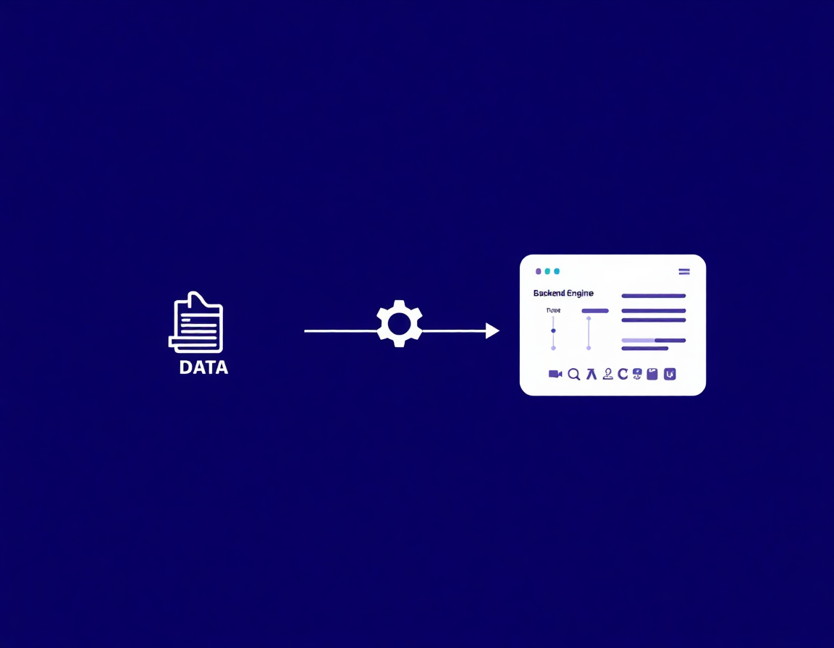
System Architecture Overview
Backend Engine
Automated processing and cleaning of raw sales data.
Advanced feature engineering to capture temporal patterns.
High-performance XGBoost regressor for model training.
Frontend Interface
Interactive web dashboard built with the Streamlit framework.
Dynamic controls for real-time adjustment of model parameters.
Integrated Matplotlib for clear trend and prediction analysis.

Slide 4
The Data Pipeline: From Raw Data to Clean Input
01.Data Ingestion
02. Sales Aggregation
03. Integrity & Cleaning
Automated loading of CSV files with specialized date-time parsing for the 'Order Date' field, ensuring temporal consistency across the dataset.
Grouping raw transactional data by date to calculate total daily sales, transforming granular records into a structured time-series format.
Handling missing values and removing incomplete records to prevent noise, ensuring the model trains on high-quality, reliable data.

Slide 5

The Heart of the System: Machine Learning
Algorithm: XGBoost Regressor
Utilizes Extreme Gradient Boosting for its superior handling of non-linear relationships and efficiency with tabular data.
Training Strategy
Implements an 80/20 temporal split, training on historical data and validating on subsequent 'future' data to simulate real-world performance.
Hyperparameter Tuning
Parameters are balanced (Learning Rate: 0.1, Max Depth: 5) to optimize for generalization and reduce forecasting error.

Slide 6
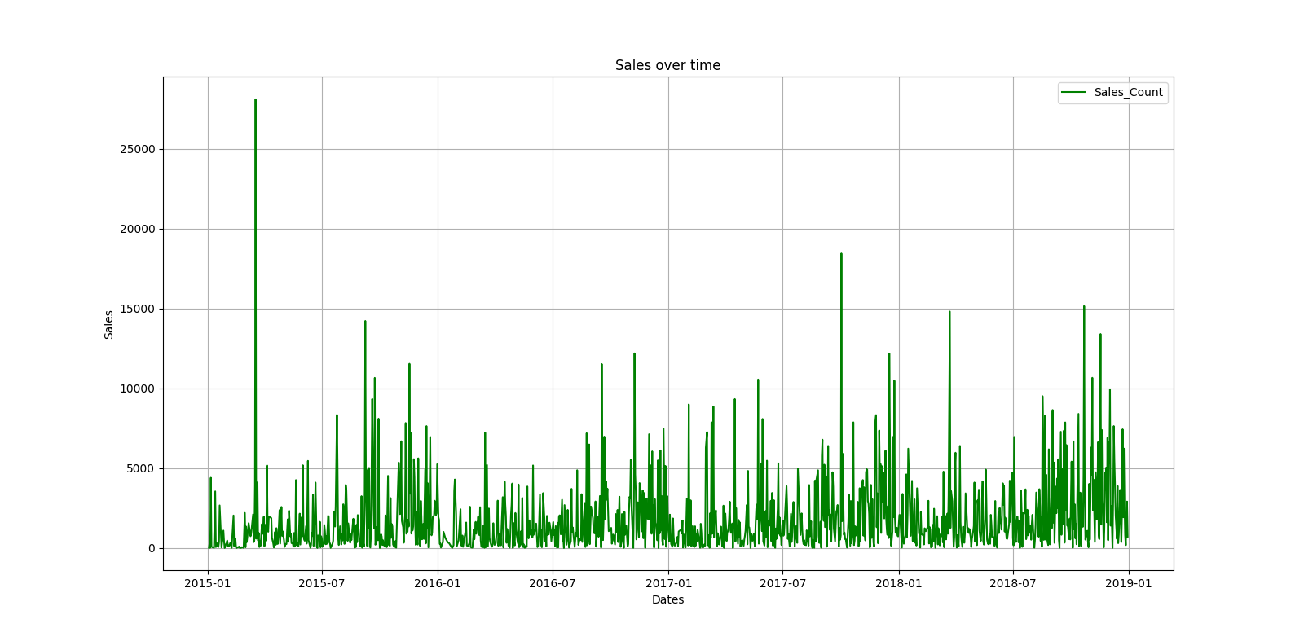
Interactive Dashboard: Putting Power in Your Hands
Key Features
A clean, intuitive web dashboard designed for non-technical users.
Simple drag-and-drop functionality for uploading CSV sales records.
Dynamic controls allow for real-time parameter tuning and re-analysis.
Visualizations of historical trends and model predictions are generated instantly.

Slide 7
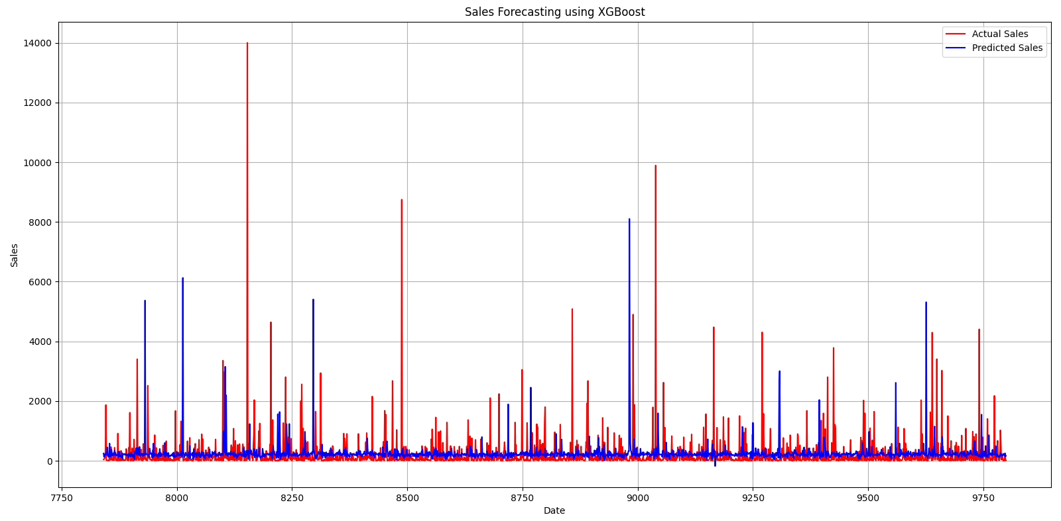
Performance Analysis: Actual vs. Predicted
The model's success is determined by its ability to accurately track real-world sales. A direct visual comparison of actual sales versus the model's predictions on test data allows for clear validation of its forecasting reliability.

Slide 8
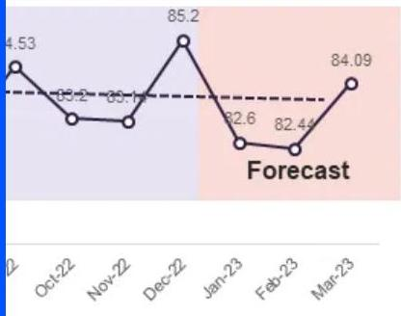
Measuring Success: Accuracy & Optimization
Root Mean Square Error (RMSE)
The model's precision is quantified using RMSE, a standard metric for regression performance. It represents the average deviation between predicted and actual sales values, offering a clear view of forecasting reliability. By monitoring RMSE changes across different configurations, the system identifies the optimal parameters for maximum accuracy.

Slide 9
Conclusion: Transforming Data into Decisions
Key Takeaway
A powerful, yet accessible tool for data-driven growth and accurate forecasting.
Efficiency
Automates the complex pipeline from raw data to actionable visual insights.v
Value
Reduces uncertainty and empowers businesses to plan with absolute confidence.

